Slide 1
Before we start…
Consider the “Coding question for the start of Lecture 7”, which you will find on Moodle…
We will discuss this question at the start of the lecture.

Slide 2
CASA0011: Agent-Based Modelling
Dr Sarah WISE
Dr Thomas OLÉRON EVANS
s.wise@ucl.ac.uk
thomas.evans.11@ucl.ac.uk
Moodle password: ABM20
Centre for Advanced
Spatial Analysis,
90 Tottenham Court Road

Slide 3
LECTURE 7 Modelling Competitive Agents

Slide 4
OBJECTIVES 1. Consider a case study on investigating, visualising and measuring model outcomes. 2. Understand the basics of Game Theory and how it can be used to model competitive interactions. 3. Gain experience of programming agents with memory in NetLogo.

Slide 5
Course Objectives
You should...
1. understand the principles of
agent-based modelling (ABM).
2. be able to describe the type and range of systems to which ABM can be profitably and appropriately applied.
3. be able to conceptualise and model
urban systems with complex dynamics.
4. show evidence of being able to translate your
understanding into the practical methodology of modelling

Slide 6
The ABM Course
Week 1: Introduction to ABMs
Week 2: Cellular Automata
Week 3: ABM Methodology
Week 4: Agent Behaviours
Week 5: ABMs as Research Tools
READING WEEK
Week 6: Modelling Competitive Agents
Week 7: Presenting Results
Week 8: Forecasting & Prediction
Week 9: Verification and Validation of ABMs
Week 10: Applications of Agent Based Modelling

Slide 7
Feedback

Slide 8
Before we start…
Consider the “Coding question for the start of Lecture 6”, which you will find on Moodle…
We will discuss this question at the start of the lecture.

Slide 9
Final Project

Slide 10
Competitive Agents Principles of Game Theory

Slide 11
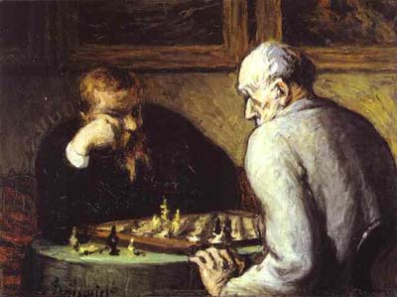
What is a Game?
Any situation in which different players compete to maximise a payoff.
Players may be people, businesses, animals, computers, etc.
Payoff could be profit, reproductive fitness, utility, etc.
The payoff to each player depends on decisions that they all make.

Slide 12
Example

Slide 13
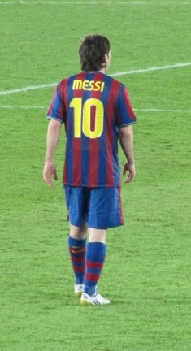
Example
https://commons.wikimedia.org/wiki/File:Messi_vs_Atlante.JPG

Slide 14
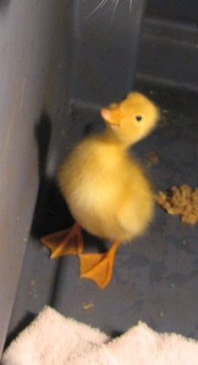
Example
https://commons.wikimedia.org/wiki/File:Messi_vs_Atlante.JPG

Slide 15
Example
https://commons.wikimedia.org/wiki/File:Messi_vs_Atlante.JPG

Slide 16
Example
Your Decision
https://commons.wikimedia.org/wiki/File:Messi_vs_Atlante.JPG

Slide 17

Example
Field the
Duck!
Don’t Field the Duck
Your Decision
https://commons.wikimedia.org/wiki/File:Messi_vs_Atlante.JPG

Slide 18
Example
Field the
Duck!
Don’t Field the Duck
Your Decision
Opponents’Decision
https://commons.wikimedia.org/wiki/File:Messi_vs_Atlante.JPG

Slide 19
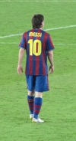
Example
Field the
Duck!
Don’t Field the Duck
Your Decision
Don’t
Field
Messi
Field
Messi
Opponents’Decision
https://commons.wikimedia.org/wiki/File:Messi_vs_Atlante.JPG

Slide 20
Example
Field the
Duck!
Don’t Field the Duck
Your Decision
Don’t
Field
Messi
Don’t
Field
Messi
Field
Messi
Field
Messi
Opponents’Decision
https://commons.wikimedia.org/wiki/File:Messi_vs_Atlante.JPG

Slide 21
Example
Field the
Duck!
Don’t Field the Duck
Your Decision
Don’t
Field
Messi
Don’t
Field
Messi
Field
Messi
Field
Messi
Opponents’Decision
0.8
0.2
0.01
0.5
https://commons.wikimedia.org/wiki/File:Messi_vs_Atlante.JPG

Slide 22
Example
Field the
Duck!
Don’t Field the Duck
Your Decision
Don’t
Field
Messi
Don’t
Field
Messi
Field
Messi
Field
Messi
Opponents’Decision
0.8
0.2
0.01
0.5
https://commons.wikimedia.org/wiki/File:Messi_vs_Atlante.JPG

Slide 23
Matrix Games
Opponents
(Column Player)
Don’t
Field
Messi
Field
Messi
Field
Duck
(0.8, 0.2)
(0.2, 0.8)
You
(Row Player)
Don’t
Field
Duck
(0.01,0.99)
(0.5, 0.5)

Slide 24
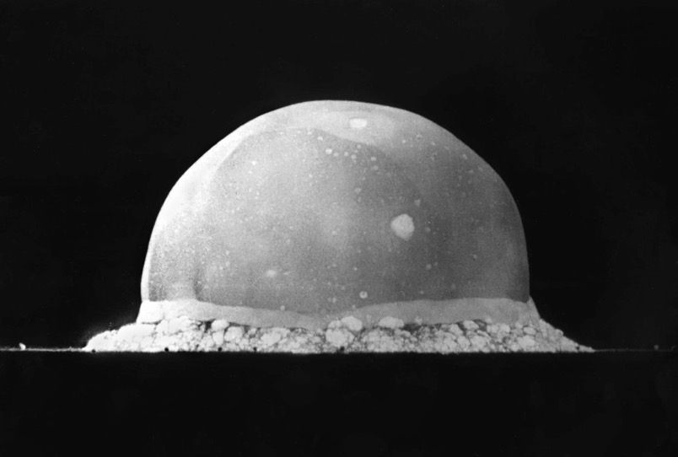
MAD

Slide 25
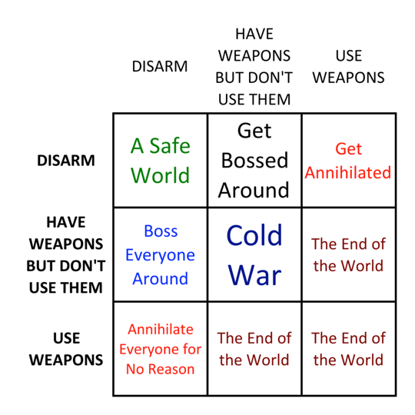
MAD

Slide 26
MAD

Slide 27
MAD

Slide 28
MAD

Slide 29
MAD

Slide 30
MAD

Slide 31
MAD

Slide 32
MAD

Slide 33
MAD

Slide 34
MAD

Slide 35
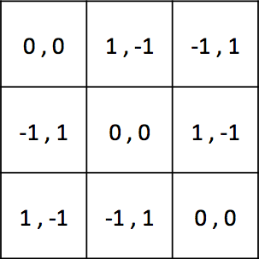
Matrix Games
A
B
C
A
B
C

Slide 36
Matrix Games
A
B
C
A
B
C

Slide 37
Matrix Games
A
B
C
A
B
C

Slide 38
Matrix Games
A
B
C
A
B
C

Slide 39
What game is this...?
A
B
C
A
B
C

Slide 40
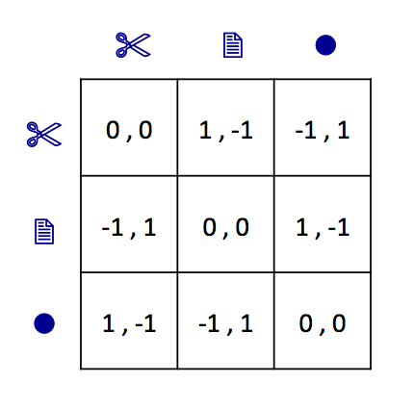

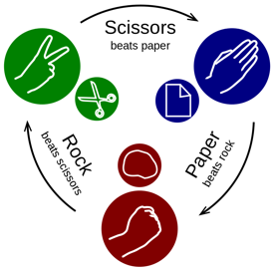
Matrix Games
Image: CC (Enzoklop) http://commons.wikimedia.org/wiki/File:Rock-paper-scissors.svg

Slide 41
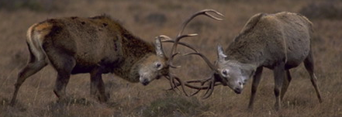
Why do some animals expend
huge amounts of energy to grow
ostentatious weapons that are
almost never used?

Slide 42
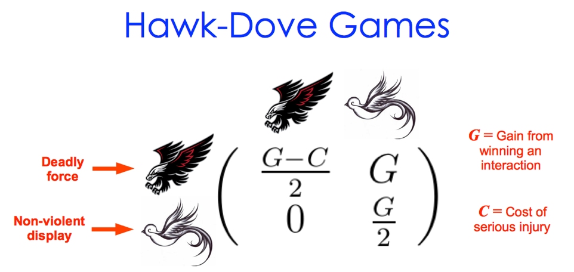

Slide 43
(100)
–50
100
0
50
(200)

Slide 44


The Prisoner’s Dilemma
Image: PD

Slide 45
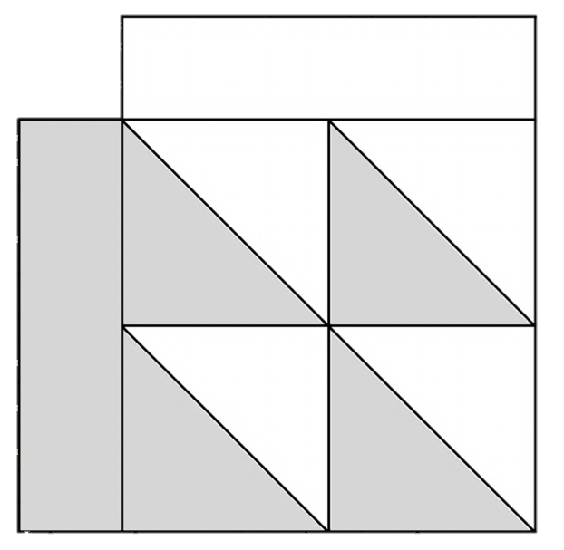
C
D
6
10
C
6
0
0
2
D
10
2

Slide 46
Clean
Dope
Fair & Honest Contest
Win
Clean
Fair & Honest Contest
Lose
Fair contest
Lose
Dope
Win
Fair contest

Slide 47
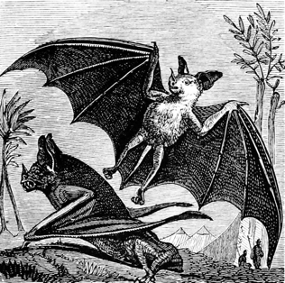
Don’t Share
Share
Good chance of survival
Almost certain to survive
Share
Good chance
of survival
No
chance
of survival
No chance of survival
Poor chance of survival
Don’t Share
Almost certain
to survive
Poor
chance
of survival

Slide 48
C
D
Play 10 rounds
against a partner.
Keep track of
your scores.
The winner is the
person with the
highest score in
the room.
6
10
C
6
0
0
2
D
10
2

Slide 49
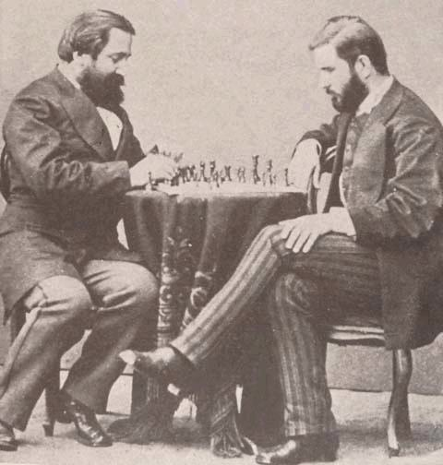
What is the best strategy?
Image: PD

Slide 50
C
D
Against...
ALWAYS C
ALWAYS D
ALTERNATE CD
6
10
C
6
0
0
2
D
10
2

Slide 51
C
D
Against...
ALWAYS C
Play ALWAYS D
ALWAYS D
ALTERNATE CD
6
10
C
6
0
0
2
D
10
2

Slide 52
C
D
Against...
ALWAYS C
Play ALWAYS D
ALWAYS D
Play ALWAYS D
ALTERNATE CD
6
10
C
6
0
0
2
D
10
2

Slide 53
C
D
Against...
ALWAYS C
Play ALWAYS D
ALWAYS D
Play ALWAYS D
ALTERNATE CD
Play ALWAYS D
6
10
C
6
0
0
2
D
10
2

Slide 54
Why do people
cooperate?

Slide 55
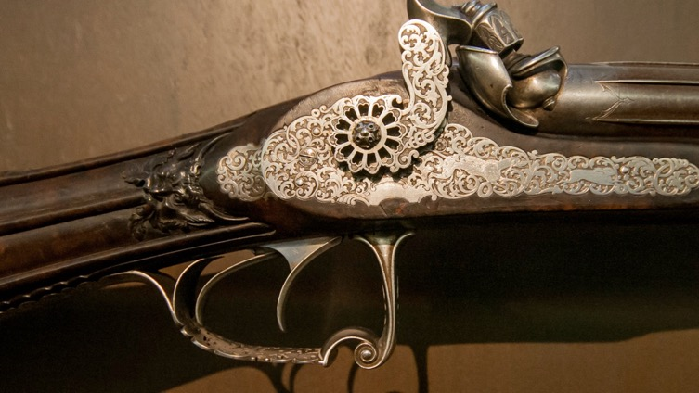
Grim Trigger
Image: CC (Hélène Rival) http://commons.wikimedia.org/wiki/File:Pistolet_incruste.jpg

Slide 56
Grim Trigger
What is the best strategy to
use against Grim Trigger?
Image: CC (Hélène Rival) http://commons.wikimedia.org/wiki/File:Pistolet_incruste.jpg

Slide 57
So what is the best strategy?

Slide 58
So what is the best strategy?
ANSWER: There is no best strategy !
(Unless you know your opponent's strategy)
BUT...

Slide 59
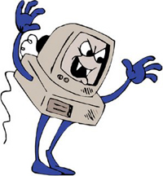
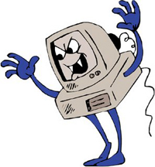
The Axelrod Tournaments
Image: http://www.angleseycomputersolutions.com

Slide 60
The Axelrod Tournaments
Tournament 1
Winner:
Tournament 2
Winner:

Slide 61
The Axelrod Tournaments
Tournament 1
Winner: TIT FOR TAT
Tournament 2
Winner:

Slide 62
The Axelrod Tournaments
Tournament 1
Winner: TIT FOR TAT
Tournament 2
Winner: TIT FOR TAT

Slide 63
Tit For Tat
??? :
TFT :

Slide 64
Why is TFT so effective?
??? :
TFT :

Slide 65
Why is TFT so effective?
??? :
TFT :
1) NICE

Slide 66
Why is TFT so effective?
??? :
TFT :
1) NICE
2) UNEXPLOITABLE

Slide 67
Why is TFT so effective?
??? :
TFT :
1) NICE
2) UNEXPLOITABLE
3) SIMPLE

Slide 68
Why is TFT so effective?
??? :
TFT :
1) NICE
2) UNEXPLOITABLE
3) SIMPLE
4) FORGIVING

Slide 69
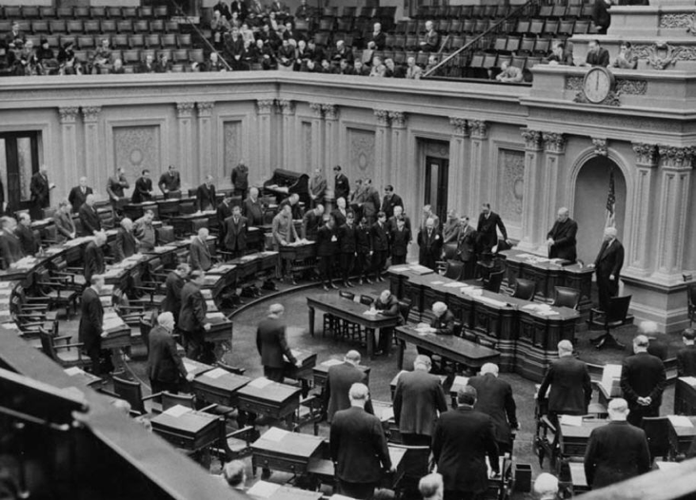
What is the relevance?
Image: PD

Slide 70
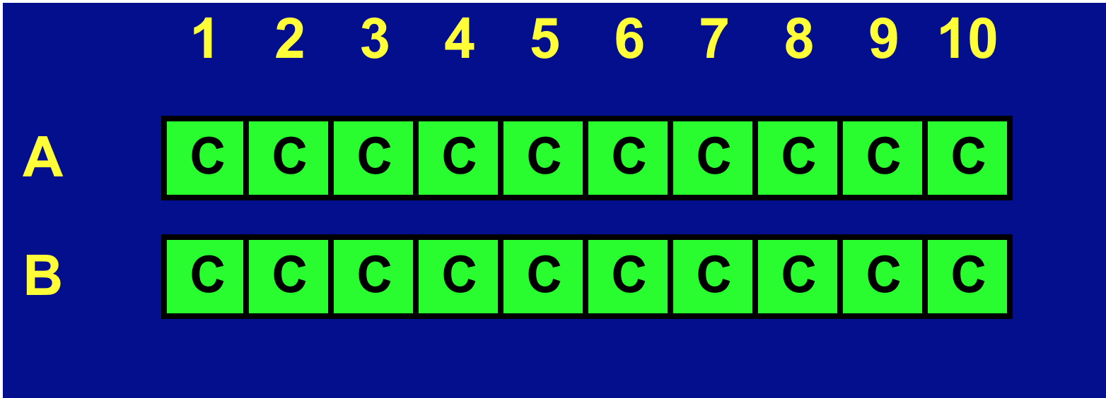
Problem Solved?

Slide 71
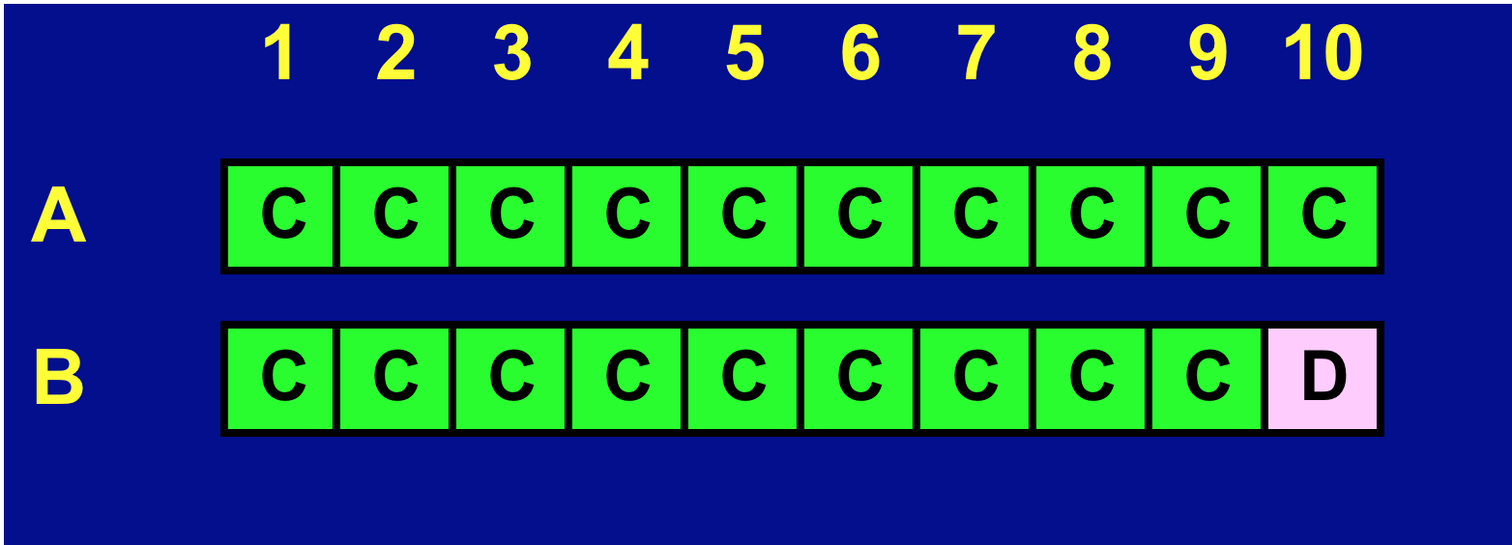
Problem Solved?

Slide 72
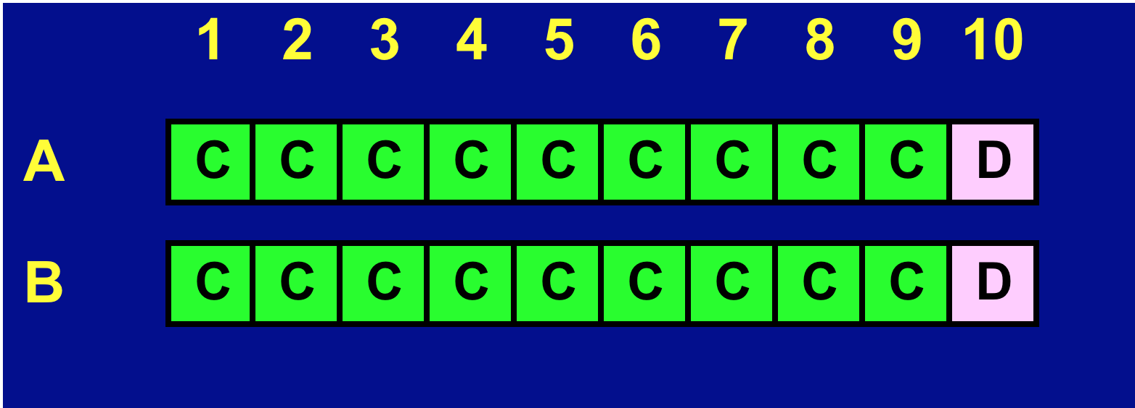
Problem Solved?

Slide 73
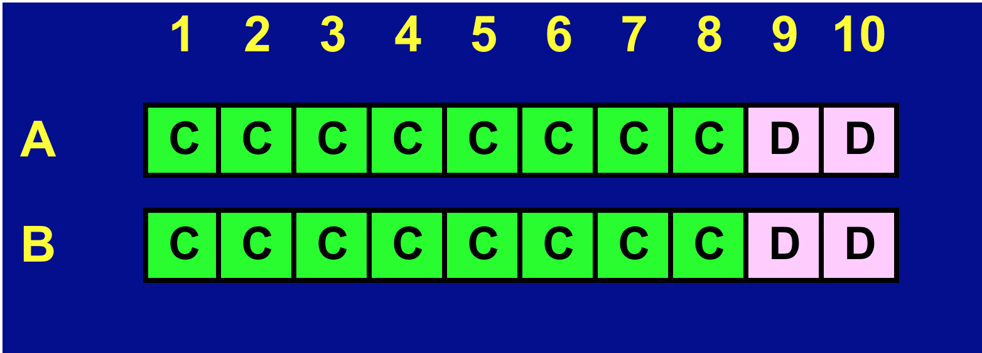
Problem Solved?

Slide 74
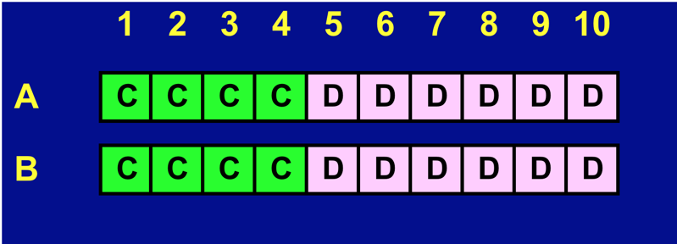
Problem Solved?

Slide 75
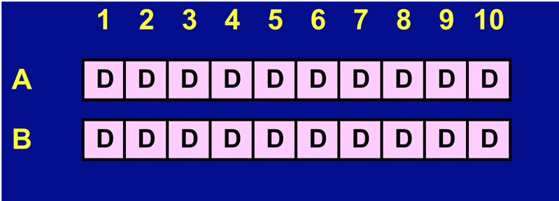
Problem Solved?

Slide 76
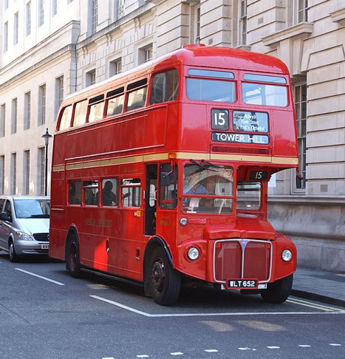
What keeps people cooperating?
Would you rather
have £100 today...
… or £1 in a
year's time?
Image: CC (Hideyuki KAMON) http://commons.wikimedia.org/wiki/File:London_bus_in_Whitehall,_5_August_2007.jpg

Slide 77
What keeps people cooperating?
Would you rather
have £100 today...
… or £___ in a
year's time?
Image: CC (Hideyuki KAMON) http://commons.wikimedia.org/wiki/File:London_bus_in_Whitehall,_5_August_2007.jpg

Slide 78
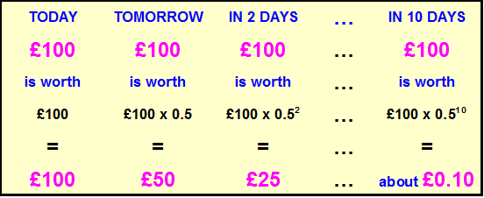
Future Utility
Suppose the discount parameter is w = 0.5 :
In this example, the total utility over 10 days is:
100.00 + 50.00 + 25.00 + … + 0.10 ≈ 199.80

Slide 79
1 p p² p³ p⁴ p⁵

Slide 80
Discount Parameter
1 p p² p³ p⁴ p⁵
1 1/2 1/4 1/8 1/16 1/32

Slide 81
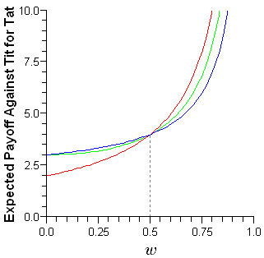
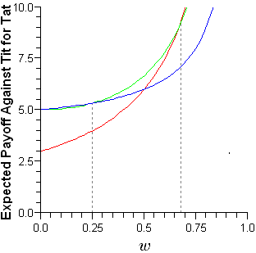
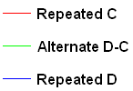
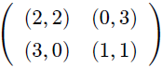
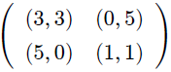
Best Response to TFT
For
For
If w is large enough then the
best response to TFT is “Always C”

Slide 82
What keeps people cooperating?
Image: CC (Hideyuki KAMON) http://commons.wikimedia.org/wiki/File:London_bus_in_Whitehall,_5_August_2007.jpg

Slide 83
How can cooperation be promoted...?

Slide 84
How can cooperation be promoted...?
Axelrod’s 5 Rules
Increase the likelihood of continued interactions;
Change the payoffs;
Teach altruism;
Teach reciprocity;
Make participants more recognisable to one another.

Slide 85

http://ncase.me/trust/

Slide 86
How might strategies change
over time across a population?

Slide 87
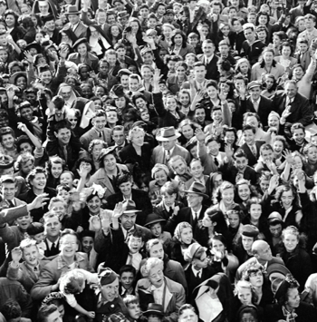
Game Theory Population Models
Assume…
Large population of individuals.
Individuals interact randomly in pairs.
Interactions take the form of a two-player game (e.g. the Prisoner’s Dilemma).
How will the strategies used by the population change as time passes?
Large Population of Players

Slide 88
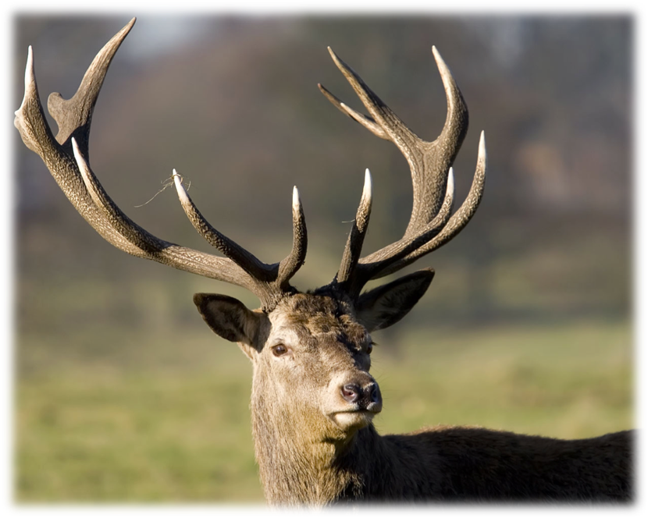

Slide 89
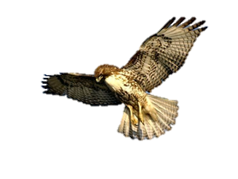


Hawks and Doves
– 4
0
– 4
2
2
1
0
1
https://www.youtube.com/watch?v=RAKjII7xCdk

Slide 90
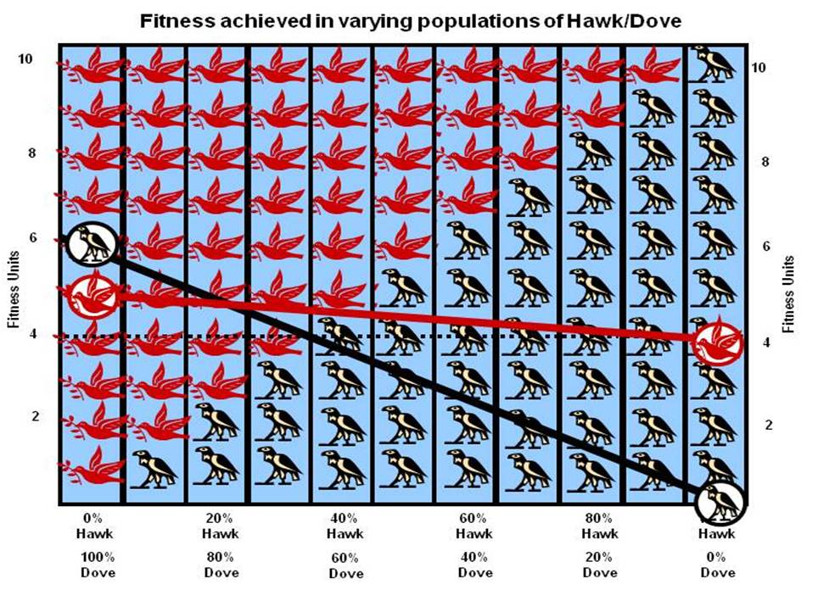

Slide 91
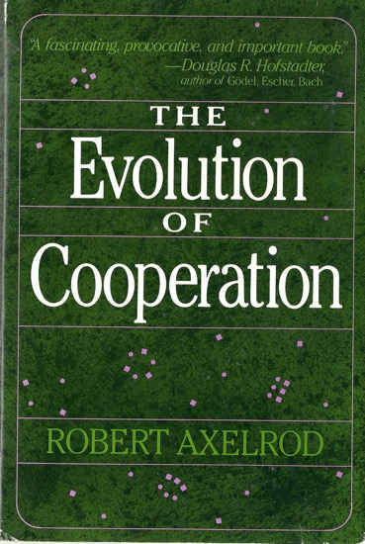
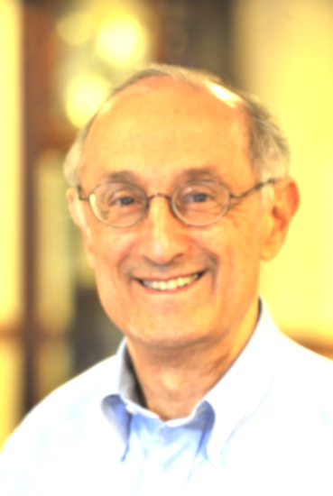
Suggested Reading

Slide 92
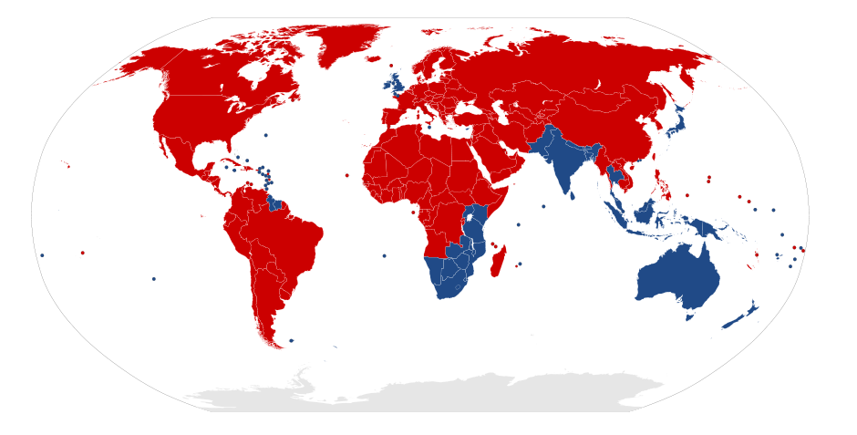
What does this map show...?

Slide 93
OBJECTIVES 1. Understand the basics of Game Theory and how it can be used to model competitive interactions. 2. Gain experience of programming agents with memory in NetLogo.

Slide 94
The Axelrod Tournaments
Tournament 1 (c. 1980)
Winner: TIT FOR TAT
Tournament 2 (c. 1980)
Winner: TIT FOR TAT
Tournament 3 (2004)
Winner:

Slide 95
The Axelrod Tournaments
Tournament 1 (c. 1980)
Winner: TIT FOR TAT
Tournament 2 (c. 1980)
Winner: TIT FOR TAT
Tournament 3 (2004)
Winner: JENNINGS TEAM LEADER

Slide 98
?
TFT

Slide 99
?
TFT

Slide 100
?
TFT

Slide 102
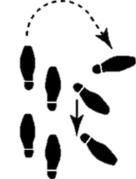
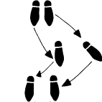

Slide 103
!
!

Slide 104
C
?
TFT
D

Slide 107
?

Slide 108
?

Slide 109
C
?
TFT
D
D
?

Slide 110
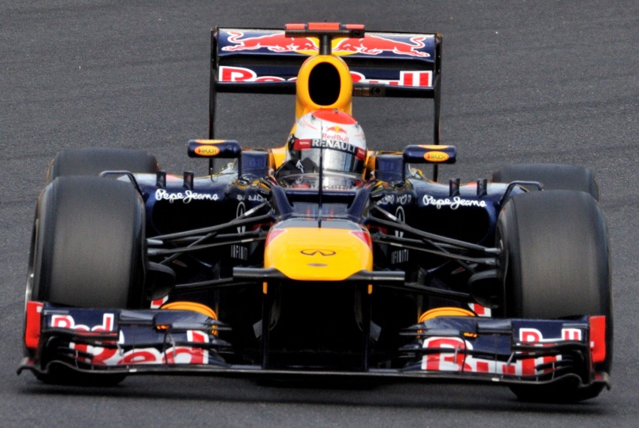
Image: CC (Michael Elleray) http://commons.wikimedia.org/wiki/File:2012_Japan_GP_-_Vettel.jpg

